Slide 1
ER-to-Relational Mapping

Slide 2
ER-to-Relational Mapping
There is almost a one-to-one correspondence between the ER constructs and the relational ones.
The two major distinctions are:
In a relational schema, relationships are represented implicitly through primary and foreign keys of participating entities.
In a relational schema, columns of relations cannot be multi-valued or composite.
Composite attributes are replaced with their simple component ones, and
Multi-valued attributes are stored in a separate relations.

Slide 3
Mapping Algorithm
For each strong entity type E:
Create a new table
Include as its columns, all the simple attributes and simple components of the composite attributes of E.
Identify the primary key and the alternate keys

Slide 4
Mapping Algorithm … Weak Entities
For each weak entity W that is associated with only one 1:1 identifying owner relationship.
Identify the table T of the owner entity type.
Include as columns of T, all the simple attributes and simple components of the composite attributes of W.
For each weak entity W that is associated with 1:N or M:N identifying relationship, or participates in more than one relationship:
Create a new table T.
Include as its columns of T, all the simple attributes and simple components of the composite attributes of W.
Form its primary key by including as a foreign key in R, the primary key of its owner entity.

Slide 5
Mapping Algorithm … Binary Relationships
For each binary 1:1 relationship type R
Identify the tables S and T of the participating entity types.
Choose S (preferably the one with total participation).
Include as foreign key in S, the primary key of T.
Include as columns of S, all the simple attributes and simple components of the composite attributes of R.
For each binary 1:N relationship type R.
Identify the table S (at the N-side) and Tof the participating entities.
Include as foreign key in S, the primary key of T.
Include as columns of S, all the simple attributes and simple components of composite attributes of R.

Slide 6
Mapping Algorithm … Any Relationship
For each N-ary relationship (including binary N:M relationship) type R
Create new table T.
Include as columns of T, all the simple attributes and simple components of composite attributes of R.
Include as foreign keys, the the primary keys of the participating (strong or weak) entity types.
Specify as the primary key of T, the list of foreign keys.

Slide 7
Mapping Algorithm … Multi-valued Attributes
For each multi-valued attribute A.
Create new table T.
Include as columns of T, the simple attribute or simple components of of the attribute A.
Include as foreign keys, the the primary key of the entity or relationship type that has A.
Specify as the primary key of T, the foreign key and the columns corresponding to A.

Slide 8
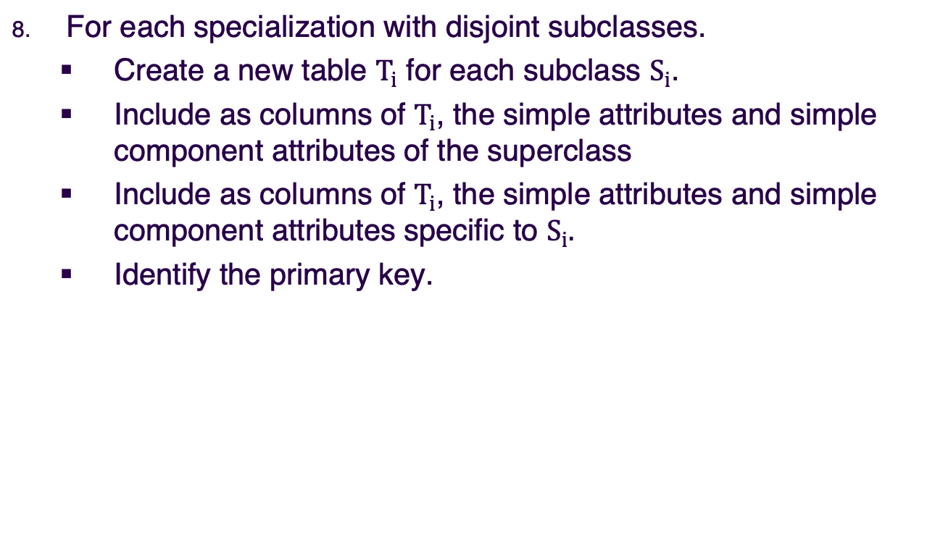
EER Mapping Algorithm
For each specialization with disjoint subclasses.
Create a new table $T_{i}$ for each subclass $S_{i}$.
Include as columns of $T_{i}$, the simple attributes and simple component attributes of the superclass
Include as columns of $T_{i}$, the simple attributes and simple component attributes specific to $S_{i}.$
Identify the primary key.

Slide 9
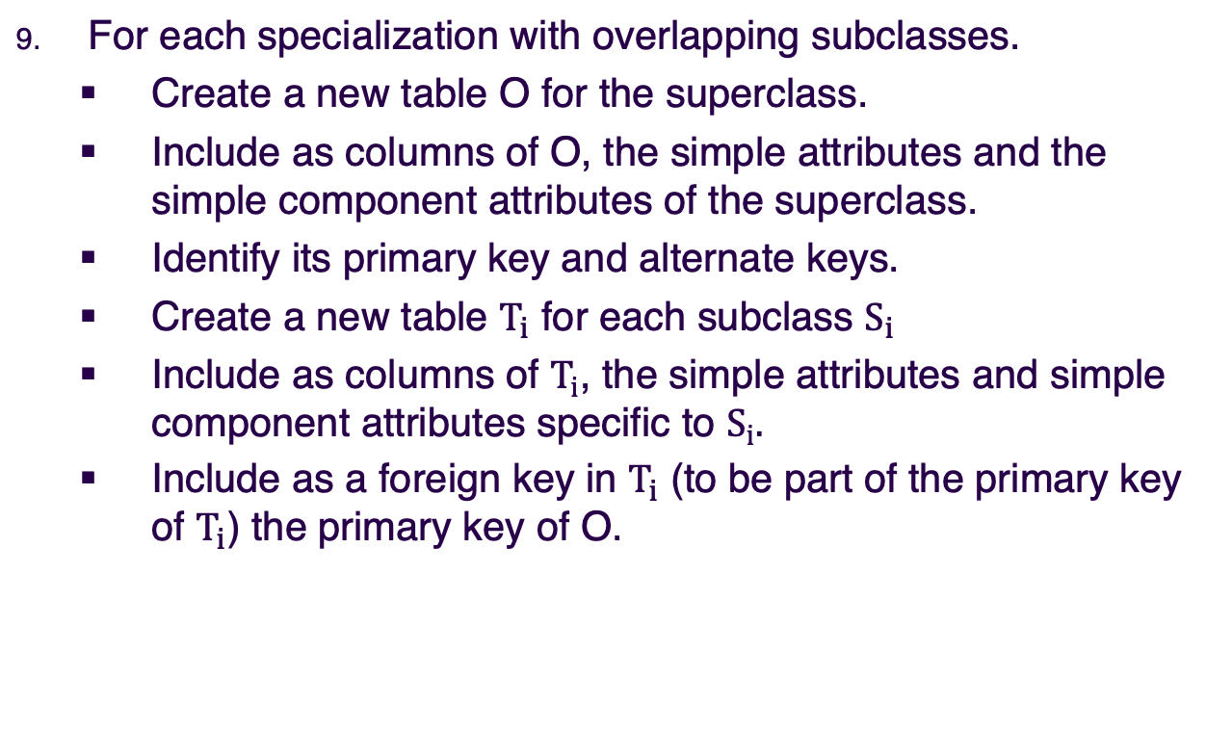
EER Mapping Algorithm
For each specialization with overlapping subclasses.
Create a new table O for the superclass.
Include as columns of O, the simple attributes and the simple component attributes of the superclass.
Identify its primary key and alternate keys.
Create a new table $T_{i}$ for each subclass $S_{i}$
Include as columns of $T_{i}$, the simple attributes and simple component attributes specific to $S_{i}.$
Include as a foreign key in $T_{i}$ (to be part of the primary key of $T_{i}$) the primary key of O.

